Slide 1
Weather Forecasting with MATLAB
Jeremiah Greer, Derek Schulte, and Karen Hildebrant

Slide 2
Methods of Forecasting
The Persistence Method
The weather of tomorrow is exactly like the weather of today
The Climatology Method
The weather of a certain day is the average of all the weather conditions for that day throughout the past
The Analog Method
To predict the weather of tomorrow, take the weather conditions from the previous three days and find a similar sequence in the past
The prediction is the day immediately after the sequence

Slide 3
The Data
Weather at CVG Airport from January 1, 1974 to October 31, 2014
Hourly temperature data for Cincinnati in 2010
All versions of the weather model checked the validity of the date chosen by the user:
Numeric values for day, month, and year
1 ≤ day ≤ 31
Valid day-month combination (e.g. prompting the user for a new day if they enter February 30)
Chosen year within dataset (allowing us to measure accuracy of predictions against data)

Slide 4
The Persistence Method
The user chooses a date for which to predict the weather
The model predicts the weather to be the same conditions as the previous day
Essential code:
chosendayindex = find(W.Year == year & W.Month == month_index & W.Day == day);
prediction = W(chosendayindex-1,2:7);
actual = W(chosendayindex,2:7);

Slide 5
The Climatology Method
The user chooses a date for which to predict the weather
The model predicts the weather to be the average of the conditions for that same day throughout the past
Essential code:
pastdays = find(W.Month == month_index & W.Day == day & W.Year < year & W.SNWD ~= -9999 & W.SNOW ~= -9999);
prediction = mat2dataset(mean(double(W(pastdays,2:6))), 'VarNames',{'PRCP','SNWD','SNOW','TMAX','TMIN'});
actual = W(find(W.Year == year & W.Month == month_index & W.Day == day),2:6);

Slide 6
The Analog Method
The user chooses a date for which to predict the weather
The model searches for a similar sequence of weather in the past to make the prediction
Finding matches for the previous three days
chosendayindex = find(W.Year == year & W.Month == month_index & W.Day == day);
previous3days = W((chosendayindex-3:chosendayindex-1),1:6);
percentrange = [0.99 1.01];
day1 = [ ]; day2 = [ ]; day3 = [ ];

Slide 7
The Analog Method (cont.)
while isempty(day1) || isempty(day2) || isempty(day3)
rangePRCP = [previous3days{1,2}*percentrange(1) previous3days{1,2}*percentrange(2)];
rangePRCP2 = [previous3days{2,2}*percentrange(1) previous3days{2,2}*percentrange(2)];
rangePRCP3 = [previous3days{3,2}*percentrange(1) previous3days{3,2}*percentrange(2)];
** also calculate ranges for SNWD, SNOW, TMAX, and TMIN
day1 = find(W.DATE ~= W.DATE(chosendayindex-3) & W.PRCP >= rangePRCP(1) & W.PRCP <= rangePRCP(2) & W.SNWD >= rangeSNWD(1) & W.SNWD <= rangeSNWD(2) & W.SNOW >= rangeSNOW(1) & W.SNOW <= rangeSNOW(2) & W.TMAX >= rangeTMAX(1) & W.TMAX <= rangeTMAX(2) & W.TMIN >= rangeTMIN(1) & W.TMIN <= rangeTMIN(2));

Slide 8
The Analog Method (cont.)
day2 = find(ismember(W.DATE,W.DATE(day1+1)) & W.PRCP >= rangePRCP2(1) & W.PRCP <= rangePRCP2(2) & W.SNWD >= rangeSNWD2(1) & W.SNWD <= rangeSNWD2(2) & W.SNOW >= rangeSNOW2(1) & W.SNOW <= rangeSNOW2(2) & W.TMAX >= rangeTMAX2(1) & W.TMAX <= rangeTMAX2(2) & W.TMIN >= rangeTMIN2(1) & W.TMIN <= rangeTMIN2(2));
day3 = find(ismember(W.DATE,W.DATE(day2+1)) & W.PRCP >= rangePRCP3(1) & W.PRCP <= rangePRCP3(2) & W.SNWD >= rangeSNWD3(1) & W.SNWD <= rangeSNWD3(2) & W.SNOW >= rangeSNOW3(1) & W.SNOW <= rangeSNOW3(2) & W.TMAX >= rangeTMAX3(1) & W.TMAX <= rangeTMAX3(2) & W.TMIN >= rangeTMIN3(1) & W.TMIN <= rangeTMIN3(2));
percentrange = [percentrange(1)-0.01 percentrange(2)+0.01];
end

Slide 9
Relationships Among Variables
Notes:
Discuss attempts to quantify relationships among the variables to refine the model

Slide 10
Relationships Among Variables
Notes:
Discuss attempts to relate precipitation to other variables

Slide 11
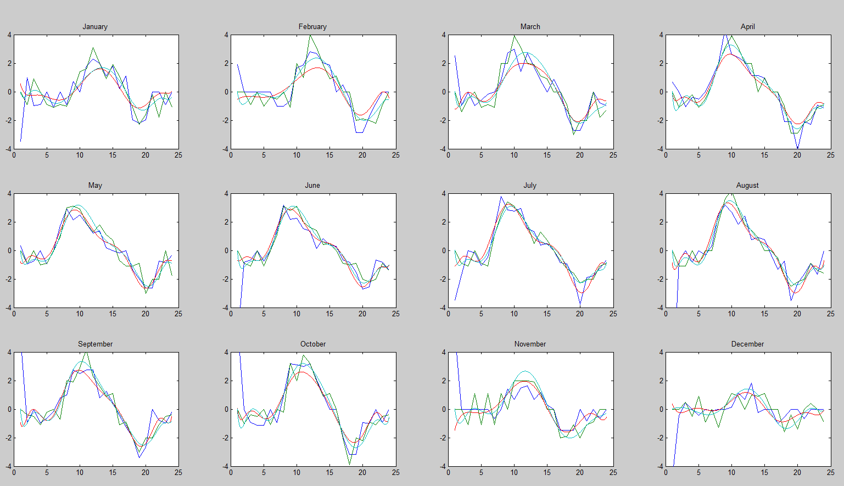
Modeling Temperature
Notes:
Temperature derivatives

Slide 12
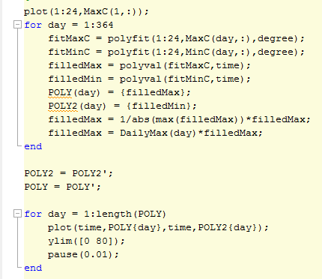
Modeling Temperature
Notes:
Code for temperature polynomials

Slide 13
Method Comparison: July 13, 2012
Actual Weather Conditions
PRCP SNWD SNOW TMAX TMIN
0 0 0 84.92 69.98
Persistence Method
PRCP SNWD SNOW TMAX TMIN
0 0 0 87.98 69.98
Climatology Method
PRCP SNWD SNOW TMAX TMIN
0.22 0 0 84.20 65.94
Analog Method
PRCP SNWD SNOW TMAX TMIN
0 0 0 93.02 69.08

Slide 14
Method Comparison: R²
 | PRCP | SNWD | SNOW | TMAX | TMIN
Persistence | 0.0131 | 0.8014 | 0.0297 | 0.8389 | 0.8391
Climatology | 0.0083 | 0.0021 | 0.0145 | 0.8241 | 0.8595
Analog | 0.0072 | 0.0006 | 0.0001 | 0.8530 | 0.8705
Analog with temperature polynomials | 0.0002 | 0.0000 | 0.0000 | 0.2471 | 0.2289

Slide 15
Conclusions and Going Further

